Slide 1

The Stanford English Language Learner Leadership Network

Slide 2
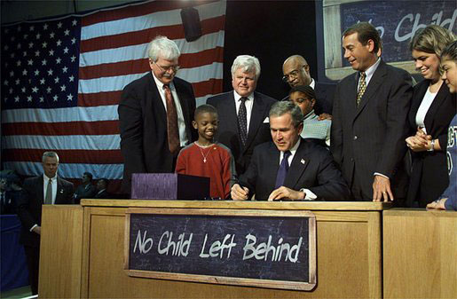
No Child Left Behind

Slide 3

No Child Left Behind:
Three important pieces for ELLs
Sec. 1111(a)(3)(ix)(III) the inclusion of limited English proficient students, who shall be assessed in a valid and reliable manner and provided reasonable accommodations on assessments administered … including, to the extent practicable, assessments in the language and form most likely to yield accurate data…
Sec. 1111(a)(3)(xiii) enable results to be disaggregated within each State, local educational agency, and school by…English proficiency status.
Sec 3113(b)(2) standards and objectives for raising the level of English proficiency that are derived from the four recognized domains of speaking, listening, reading, and writing, and that are aligned with achievement of the challenging State academic content and student academic achievement standards described in section 1111(b)(1).

Slide 4
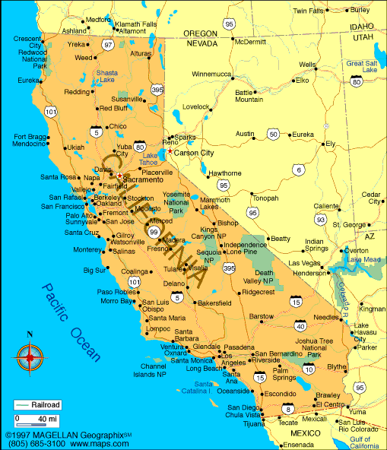

Slide 6
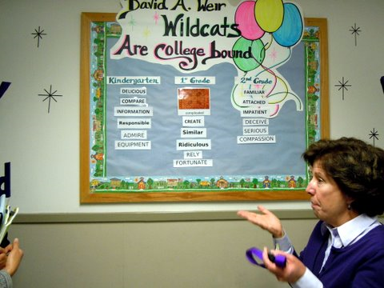
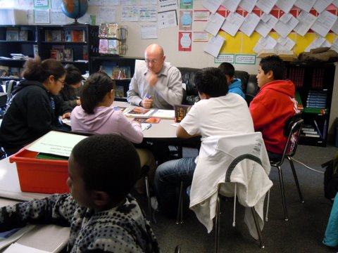
Fairfield-Suisun (K-12)
Student population: 21,972
ELL population: 4,040 (18.4%)
SES: 7,588 (34.5%) free/reduced lunch
PI Year 3
Team:
Kris Corey, Assistant Superintendent, Educational Services
Araceli Cantu-Tong, Director of EL Services
Sheila McCabe, Director of Secondary Education

Slide 8
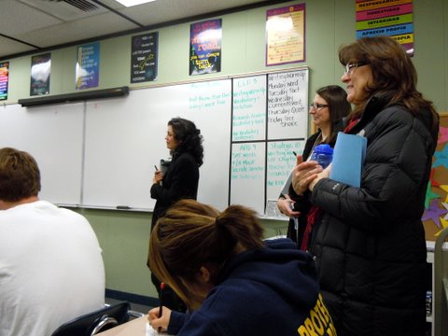
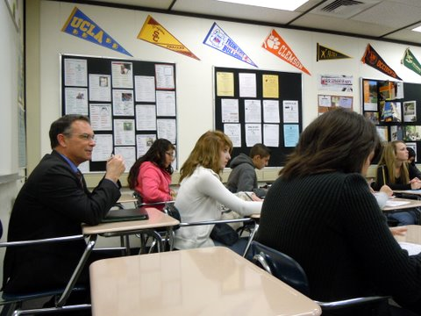
Napa Valley (K-12)
Student population: 17,959
ELL population: 3,394 (22%)
SES: 7,004 (40%) free/reduced lunch
PI Year 3
Team:
Patrick Sweeney, Superintendent
Elena Toscano, Assistant Superintendent, Instructional Services
Ivan Chaidez, Director of ELL and Alternative Ed Services

Slide 10
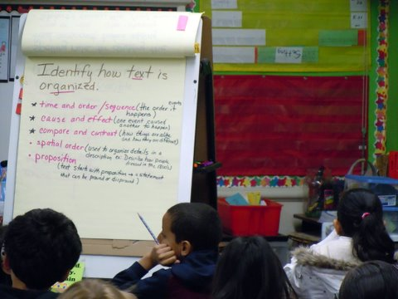
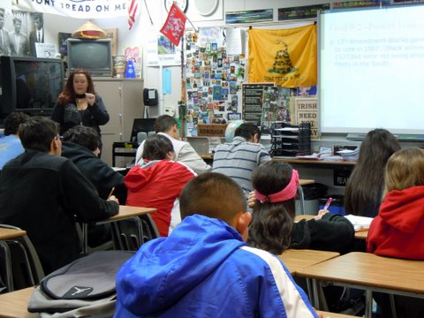
Firebaugh-Las Deltas
(K-12)
Student population: 2,252
ELL population: 934 (41.5%)
SES: 2,024 (90.4%) free/reduced lunch
Not in PI
Team:
Roy Mendiola, Assistant Superintendent
Barbara VonBieberstein, Special Projects Coordinator
Josephina Magallanes, Special Projects Clerk

Slide 12
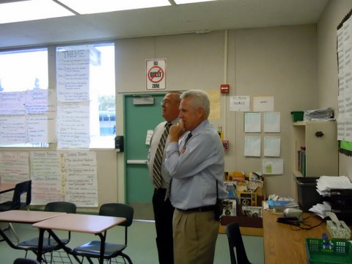
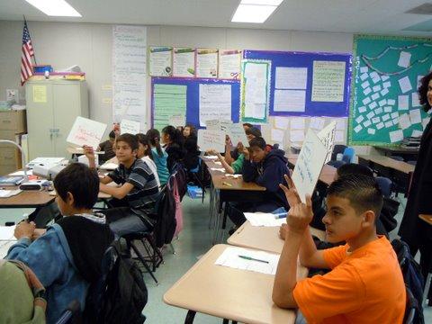
Sanger (K-12)
Student population: 10,501
ELL population: 2,479 (24%)
SES: 7,568 (71.9%) free/reduced lunch
Exited PI in 2008-2009
Team:
Rich Smith, Deputy Superintendent
Tim Lopez, Special Projects Director
Jon Yost, Network Administrator
Steve Carlson, Director of Resource Development

Slide 14
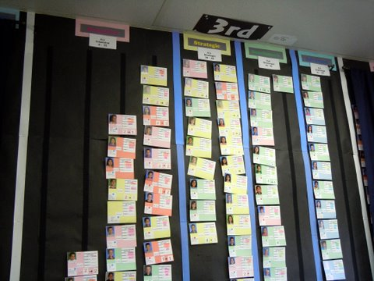
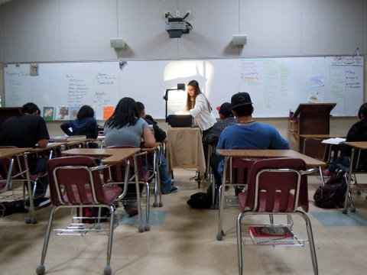
Ukiah (K-12)
Student population: 6,232
ELL population: 1,568 (25%)
SES: 4,328 (71%) free/reduced lunch
PI Year 3
Team:
Lois Nash, Superintendent
Lynn Zimmermann, Director of Curriculum and Instruction

Slide 16
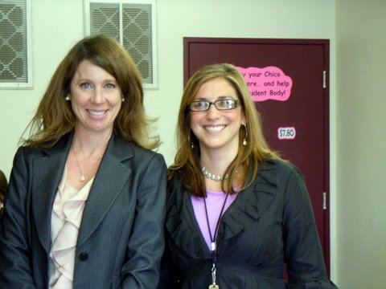
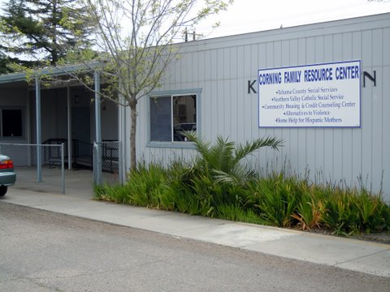
Corning Elementary
(K-8)
Student population: 1,913
ELL population: 656 (34%)
SES: 1,575 (83%) free/reduced lunch
PI Year 3
Team:
Steve Kelish, Outgoing Superintendent
Catherine Reimer, Incoming Superintendent
Megan Neely, District ELD Coordinator and Principal
Dave Sweringen, Migrant Education Coordinator and Principal

Slide 18
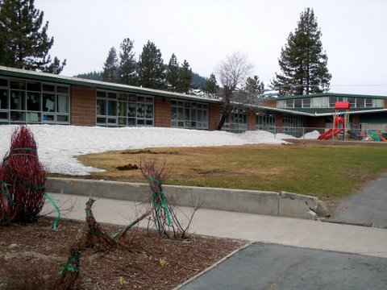
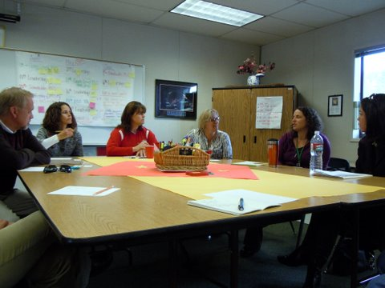
Tahoe-Truckee (K-12)
Student population: 3,949
ELL population: 943 (24%)
SES: 1,492 (38%) free/reduced lunch
PI Year 3
Team:
Steve Jennings, Superintendent
Dave Curry, Director of Educational Service
Nicole Sayegh, EL Programs Coordinator

Slide 19
Our Work over the next two years together…
focuses on three key intertwining areas of work identified by network participants
  EL Data Analysis
  Systems-Level Practices
  Classroom and PLC observation
    Reflect Camera
    Inter-district Visits

Slide 20
Mutually Supported Priorities
EL Data Analysis
  Allows for fine grain analysis of longitudinal EL academic progress
  Supports identification of barrier(s) to EL student achievement
  Can be monitored regularly for progress
Notes:
20

Slide 21
Mutually Supported Priorities
Systems Level Practices
  Contrast own practices with those of other districts to posit alternative program configurations for ELs
  Supports identification of systems-level barriers to EL student achievement
  Insures changes to EL program occur at classroom, site and district level
Notes:
21

Slide 22
Mutually Supported Priorities
Classroom and PLC observation
  Corroborates identification of focus in conjunction with EL achievement data
  Builds capacity of network participants to deepen expertise in optimal instructional practices for EL
  Allows for monitoring of action plan implementation in year three
Notes:
22

Slide 23
Short and Long Term Outcomes
Short Term Outcomes
  Identification of API Target Goals (and other common indicators, where available) for EL Subpopulation
  Creation of Action Plans based on multiple data points
  Enhanced quality of EL student data
Long Term Outcomes
  Creation of collaborative relationship that continue beyond life of project
  Gains in API as a result of implementation of Action Plans
Notes:
23

Slide 24
Each phase in the two-year process informs the next
In person meetings at Stanford
Participant Webinars
Inter-district Visits

Slide 25
Year Two Network Activities
Data
Systems-Level Practices
Classroom/PLC Observation
Winter ‘12
Spring ‘12
Spring ’12
Stanford Meeting
Analyze cohort assessment data across districts. Establish growth targets. Identify EL Target Students
Review and compare strategic, non-compliant elements of the EL Master Plan
Problematize systems-level dilemmas in groups
Present framework and timeline and develop focus for Inter-district visits
Ground observation protocol with videos
Discuss/develop process for classroom filming
Inter-district Visits (#1)
Host districts revisit observation focus based on data analyses and/or systems-level dilemmas
Observers take descriptive notes while visiting classes
Observation debrief
Reach consensus on findings from visit
Host and participants agree upon next steps in work
Webinar
Hosts from visits present findings, action steps, and additional support(s) requested from network
Visit participants present learnings, action steps
Discussion of similarities/differences among other site visits
Feedback provided by experts in field of EL education. Appropriate resources recommended (e.g., research-based readings, webinars) where appropriate
Year Two

Slide 26
Year Two Network Activities (cont.)
Data
Systems-Level Practices
Classroom/PLC Observation
Summer ‘12
Fall ‘12
Fall ’12
Stanford Meeting
Discuss Target ELL students’ progress—data (benchmarks), program, student work. Discuss process for shadowing students during fall semester
Districts present video clip from their sites
Create calendar for fall site visits. Brainstorm potential foci for years’ visits.
Common Core Update
Reflect on learnings from last 9 months, including inter-district visits, webinars, and in person meetings.
Inter-district Visits (#2)
Focus for visit determined at summer meeting
Visits include ELD, sheltered and/or mainstream classes with target ELs
Webinar
Hosts from visits present findings, action steps, and additional support(s) requested from network
Visit participants present learnings, action steps
Discussion of similarities/differences among other site visits
Additional options on slide # 8-9
Year Two

Slide 27
Year Three Network Activities
Data
Systems-Level Practices
Classroom/PLC Observation
Winter ‘13
Spring ‘13
Spring ’13
Stanford Meeting
Analyze cohort data from previous year—examine by program placement, e.g. mainstream vs. sheltered. Discuss target students’ progress
Discuss learnings from first two cycles of visits.
Discuss foci for upcoming inter-district visit.
Discuss protocol for PLC video observation
Common Core: Lesson exemplars that develop conceptual understanding and linguistic proficiency (video-based if available).
Inter-district Visits (#3)
Clusters with two districts can visit other districts.
Potential foci for visits could include:
Academic rigor for ELs
Academic Language Usage by ELs
Providing access to complex texts
Language modeling and development in content areas
Formative assessment and ELs
Visits may include more than one focus
Webinar
Discuss reading provided at Winter ’13 meeting.
Possible topics:
Common Core: language instruction in content areas
Instruction that supports Els in constructing meaning from complex texts.
Presentation of learnings and action steps by host districts from Interdistrict visits.
Additional Topics possible on slides #8-9
Year Three

Slide 28
Year Three Network Activities (cont.)
Data
Systems-Level Practices
Classroom/PLC Observation
Summer ‘13
Fall ‘13
Fall ’13
Stanford Meeting
Share changes made to site/district practices for ELs (program, instruction, resources) as result of network
Video sharing of PLCs and/or classroom formative assessments.
Systemic support for Common Core standards implementation
The role of PLCs in implementation of Common Core standards
District Visits by Stanford Staff
Visit sites to observe changes in instructional practice and/or program configurations for Els.
Provide feedback from final classroom observations to guide next steps
Discussion of next steps for district/site leaders based on network collaboration
Final Meeting
Analysis of final EL cohort data.
Discussion of lessons learned during collaboration.
Share plans of next steps for district work.
Identify potential next steps in collaboration.
Share with additional communities of practice.
Discuss results of survey previously provided to participants.
Year Three

